Slide 1
DIY Car Repair Assistant (T2T + I2T)
Advisor: Dr. Muhammad Aminul Islam
Team:
Ashok Kumar Jarugubilli
Bharath Chandra Reddy Ukanti
Deshik Sastry Yarlagadda
Yaswanth Labba

Slide 2
Timeline & Milestones (with status)
Repo & corpus setup (all 3 manuals) — Completed: 2025-09-20
Chunking + metadata + indices (FAISS + TF-IDF fallback) — Completed: 2025-09-22
Strict RAG answer() with safety, steps, citations — Completed: 2025-09-23
FAISS Raw index adapter (B2) integrated — Completed: 2025-09-23
Lexical TF-IDF fallback (no embeddings) — Completed: 2025-09-24
Output sanitizer & citation fallback — Completed: 2025-09-24
Vision path MVP (OCR + VLM) — Planned: 2025-10-01
Unified UI (text and image) — Planned: 2025-10-05
Eval suite (300 T2T + 120 I2T Qs) — Planned: 2025-10-10
Final polish & report — Planned: 2025-10-15

Slide 3
Deshik — Data & Ingestion / Indexing
Owner: Data & Ingestion / Indexing (all manuals).
This week:
Converted PDFs to text (PyMuPDF/pdfminer) and rendered page images (300 dpi).
Chunked text (≈900–1200 chars, 150–200 overlap) with {make, model, year, section, page}.
Built FAISS index and TF-IDF fallback; verified metadata coverage.
Code highlights:
ingest pipeline, index builders, metadata schema; saved indices for each manual.
Next: TOC/section normalization across manuals; speed optimizations.

Slide 4
Ashok — Retrieval Orchestration & RAG
Owner: Retrieval Orchestration & RAG (Text→Text).
This week:
Implemented strict `answer()` with safety-first steps/bullets and 'Missing:' guard.
Added `_finalize_answer` to prevent prompt/context echoes; no raw chunk dumps.
Router stub (make/model) and unit/synonym normalization seed.
Code highlights:
rag_core/answer.py, retrieval helpers, citation fallback (`_make_citations`).
Next: optional reranker and latency tuning (lower k, caching).

Slide 5
Bharath — Vision / OCR
Owner: Vision & OCR (Image→Text).
This week:
Prepared page image manifest and figure crop stubs per manual.
Prototype OCR pipeline (PaddleOCR/Tesseract) for labels/torque tables.
Planned VLM adapter (Qwen2-VL/LLaVA) for diagram Q&A.
Code highlights:
vision/ocr.py (draft), vision/vlm.py (interface), image→text response schema.
Next: wire OCR captions into index; VLM MVP for diagram interpretation.

Slide 6
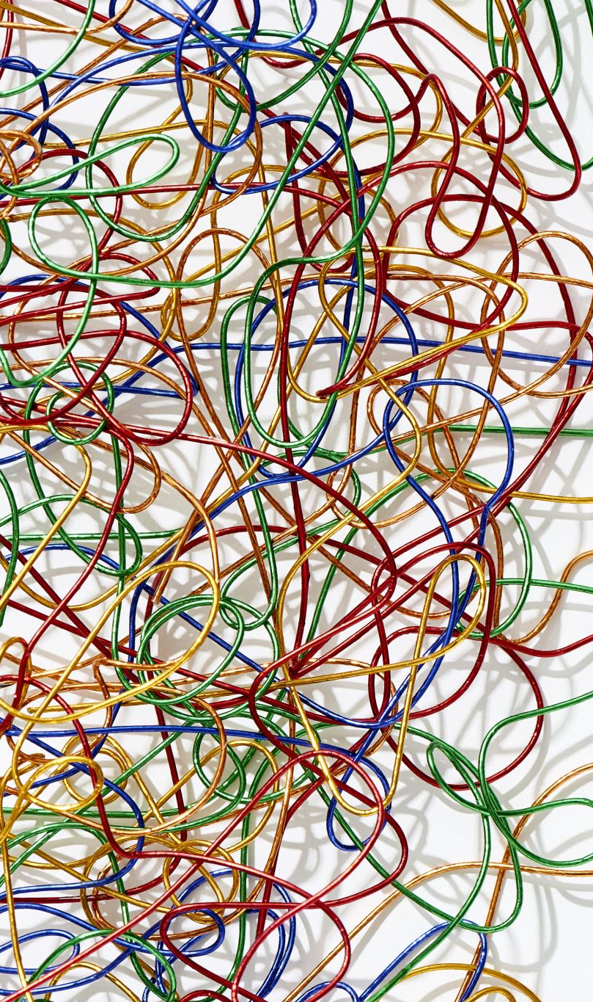
Yaswanth — API, UI & Evaluation (Planned)
Owner: API, UI & Evaluation (track planned; not implemented this week).
This week (completed):
Focused on the notebook RAG pipeline: strict `answer()` + citation fallback + TF‑IDF/FAISS wiring.
Prepared presentation artifacts (PDF + PPT).
Planned next:
FastAPI skeleton with `/answer` and `/image_answer` endpoints.
Streamlit UI: manual selector, question box, image upload; show cited pages/figures.
Evaluation harness for 300 T2T + 120 I2T questions; logging with trace IDs.

Slide 7
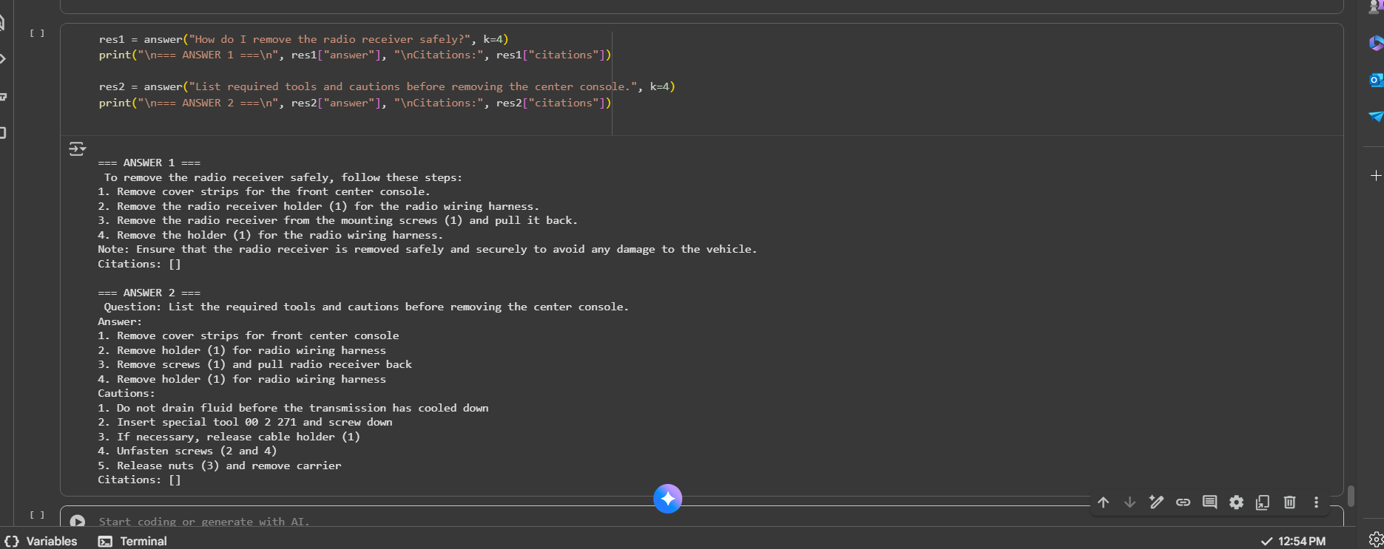

Slide 8

Notebook Demo (This Week)
Asked two queries:
“How do I remove the radio receiver safely?” → 4 clear steps
“List required tools and cautions before removing the center console.” → tools + cautions list
Pipeline: Text→Text RAG using per-manual index (FAISS IndexFlatIP) with TF-IDF fallback.
Answering: safety-first, numbered/bulleted, no raw chunk dumps (prompt + sanitizer).
Status on citations: shows [] in this run because page/source metadata isn’t attached yet; will display manual + page # once wired.
Data: we have all 3 manuals ingested (3 makes, 3 nations, each >2k pages); Mini Cooper shown here for speed.
Env/model: Colab + small open-source instruct LLM.
Next: attach page metadata, add UI/API, and wire OCR/VLM for diagram questions.

Slide 9


Weekly Summary (Prev | Current | Next)
Previous Week
• Ingested all three manuals; created per-manual indices (FAISS + TF-IDF fallback).
• Demoed Mini Cooper queries; strict RAG template drafted.
• Set up router stub and metadata schema.
Current Week
• Integrated strict `answer()` with safety & citations; echo sanitizer.
• FAISS raw index adapter (B2) working; TF-IDF fallback added.
• OCR manifest prepared; API/UI/eval scaffolds created.
Next Week
• Finish OCR → index linking; add VLM MVP for diagrams.
• Build unified UI and run evaluation (T2T + I2T).
• Latency tuning, safety sweeps, final report & demo.

